Slide 1
Updated 2 pm 1 November
Iteration 1
Draft Proposal
Set up GitHub
Gather requirements
Prototype
Iteration 3
User Login/ Logout Account Management
Services Create services & price list View list Update prices Delete records
Iteration 5
Doctors Create records View records Update records Delete records
Rules Customisation of rules for notifications
Revamp UI Improve UI Graphic representation of analysis results
Iteration 7
Template Upload email template Upload Letter of Guarantee/US Embassy Summary Screening Reminder
Email Notification Send email based on rules created Export PDF/ Word
SMS Notification Send appointment reminder to patients
Iteration 9
Fields Customisation Allow users to customise fields for forms
Search function Search for specific information in the entire application
Iteration 11
Create additional modules/ tabs Allow users to shift/ create new tabs
Currency Conversion Conversion of currency for invoice Link to Fixer.io
Iteration 13
Improve UI Bug Fixing
Preparation for Final
User Testing 1
28 Oct
User Testing 2
3 Feb
User Testing 3
17 Mar
1
2
3
4
5
6
7
8
9
10
11
12
13
14
15
4 Oct
18 Oct
1 Nov
15 Nov
29 Nov
13 Dec
27 Dec
10 Jan
24 Jan
7 Feb
21 Feb
6 Mar
20 Mar
3 Apr
17 Apr
Proposal Submission
17 Oct
Acceptance
4 Nov
Go Live
15 Feb
Midterm
20 Feb
Poster
27 Mar
Final
10 Apr
Iteration 2
Analysis KPI of different teams Ranking (Doctor, Specialty, Referral) Gender and Age Report
Timeline Cradle to grave timeline Group patients for recommended screenings based on age
Clients (Patients) Create records View records Update records Delete records
Preparation for Acceptance
Iteration 4
Exam Period
Iteration 6
Tasks Create tasks View tasks (dashboard)
Revamp UI
Iteration 8
Invoices Generate invoice Export in PDF/ Excel Track deleted records
Report Generate reports (summary of price/ services/ admission) Filter function (patient, task, period)
Iteration 10
Migration of data from client’s current system
Preparation UT 2 and Midterm
Iteration 12
Improve UI Bug Fixing
Preparation for Final
Iteration 14
Preparation for Final
Legend:
Milestones
Core
User Testing
Secondary
Non-coding tasks
Tertiary
2 weeks iteration
Good-to-have

Slide 2
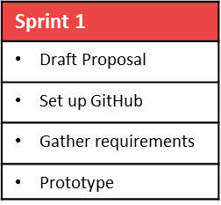
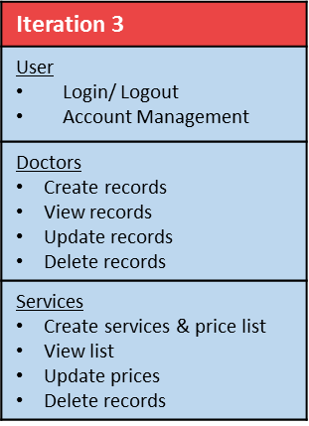
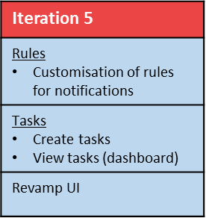
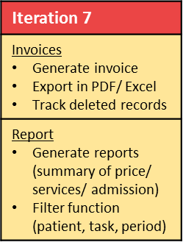
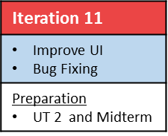
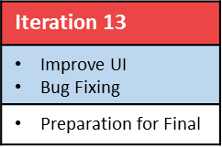
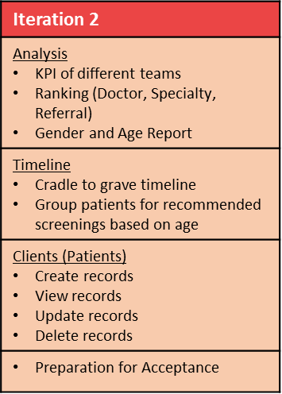

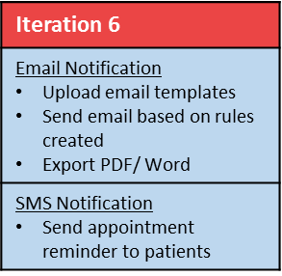
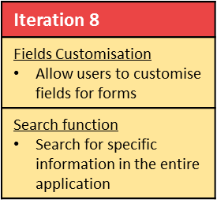
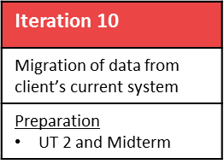
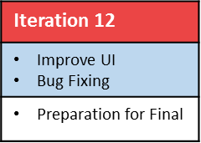
User Testing 1
28 Oct
User Testing 2
10 Feb
User Testing 3
17 Mar
1
2
3
4
5
6
7
8
9
10
11
12
13
14
15
4 Oct
18 Oct
1 Nov
15 Nov
29 Nov
13 Dec
27 Dec
10 Jan
24 Jan
7 Feb
21 Feb
6 Mar
20 Mar
3 Apr
17 Apr
Proposal Submission
17 Oct
Acceptance
4 Nov
Go Live
15 Feb
Midterm
20 Feb
Poster
27 Mar
Final
10 Apr
Legend:
Milestones
Core
User Testing
Secondary
Non-coding tasks
Tertiary
2 weeks iteration
Good-to-have

